Slide 1
Executor Node1
Executor Node2
RDD
RAM (16GB, Avail: 12GB)
RAM (16GB, Avail: 12GB)
Storage Service Call (S3/GCS/Azure BLOB)
Total Size – 200GB
100GB
100GB
Default Size for partitioning – 128MB

Slide 2
SparkContext
3
Executor Node
SparkContext
(user 1)
Multiple end user appl
2
Driver Program
YARN Master Node
PySpark Code
< by user 1 >
1
Application Master
4
Executor Node
PySpark Code
<>
PySpark Code
< by user 2 >
Executor Node
PySpark Code
<>
5
spark.driver.allowMultipleContexts = true

Slide 3
SparkSession
Executor Node
Multiple end user appl
SparkSession 1
YARN Master Node
PySpark Code
< by user 1 >
Application Master
SparkSession 2
SparkContext
SparkSession 3
Driver Program

Slide 4
Shuffling

Slide 5
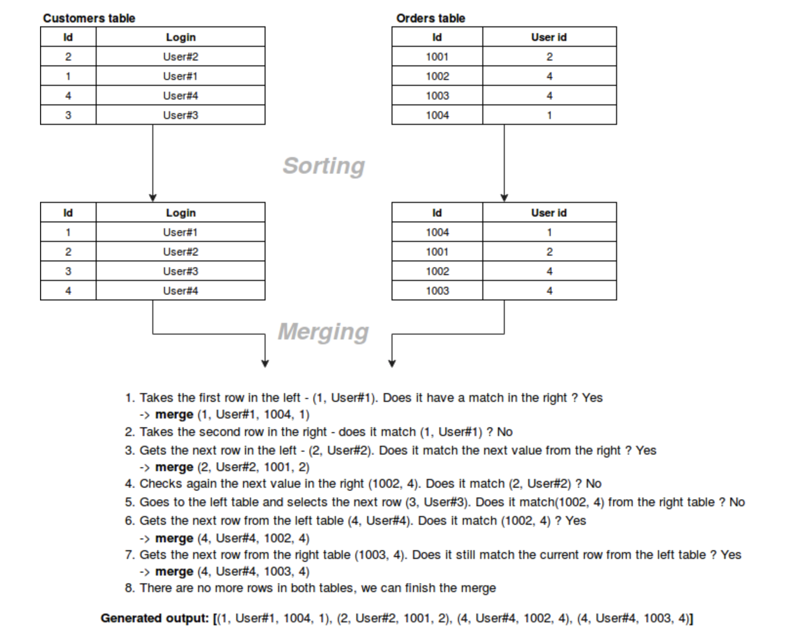
Joins – Sort Merge Join
Principle: Sort data before joining.
spark.sql.join.preferSortMergeJoin

Slide 6
Joins – Shuffle Hash Join
Shuffle
Join
Shuffle
Partition 0
Partition 1
Partition 1
Partition 3
Partition 1
Partition 0
Partition 0
Partition 2
DF 1
Partition 3
DF 2
Partition 2
Partition 3
Partition 1
Partition 3
Partition 2
Partition 2
Partition 0
Shuffle
Each shuffle will spawn a new stage – 3 stages
New DataFrame

Slide 7
Joins – Broadcast Hash Join
Join
Broadcast
Spark Driver
Partition 1
DataFrame2
Partition 0
DataFrame2
DF 1
DataFrame 2
Partition 3
DataFrame2
Partition 2
DataFrame2
Shuffle
spark.sql.autoBroadcastJoinThreshold
2 stages
New DataFrame

Slide 8
Lets see how Catalyst Optimizer works
select a1, sum(b1)
from A join B
on A.key = B.key
where b1 > 2208
group by a1
Joined1 = dfA.select(‘a1’).join(dfB.select(col(‘b1’) > 2208), [“key”], ‘inner’)
Joined2 = Joined1.groupBy(‘a1’).agg(sum(‘b1’)).show()

Slide 9
Execution Plan – Catalyst Optimizer
select a1, sum(b1)
from A join B
on A.key = B.key
where b1 > 2208
group by a1
Catalog
Spark SQL
Unresolved Logical Plan
Resolved Logical Plan
Optimized Logical Plan
Physical Plan
Cost Model
Final
Physical Plan
RDDs
DataFrame
Scan B
Scan A
Filter
Tungsten Execution
Scan B
BroadcastExchange
Scan A
BroadcastHashJoin
Filter
HashAggregate
Join
ShuffleExchange
Aggregate
HashAggregate

Slide 10
